Slide 1
Bakery Sales Prediction with Machine Learning
A Dual Approach using Linear Regression & CNN
By:
HARISHWAR REDDY MUDDAM
RAMYA KOLLU

Slide 2
Project Overview
• Goal: Predict future sales for 6 product categories
• Models used: Linear Regression and CNN
• Data sources: historical sales and weather

Slide 3
Dataset Summary
• Sales data: 2013–2018 (train.csv)
• Weather data: temperature_data.csv
• Combined with product categories and dates

Slide 4
Features Used
• category_id
• day, month, weekday
• temperature (merged from external data)

Slide 5
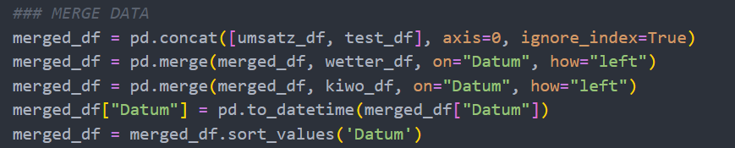
Data Characteristics
Data Preparation
Importing Libraries and loading the data from the server
Merging the data

Slide 6
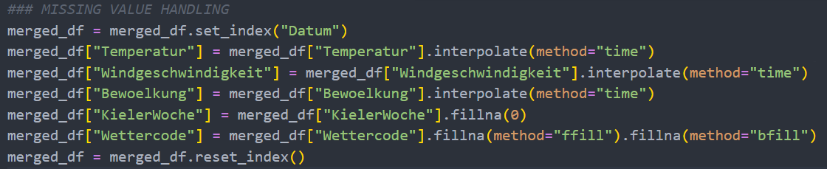
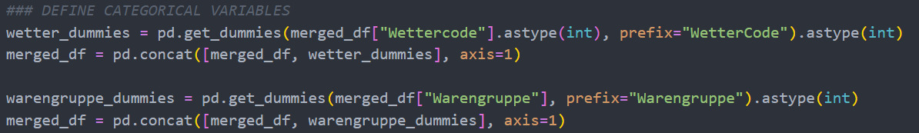
Data Characteristics
Data Preparation
Data Cleaning and Imputing
Defining categorical variables
Splitting and saving

Slide 7
Data Characteristics
Additional Variables
National/Regional Holidays and the days before (Christmas Eve, etc ) (import holidays)
DAX (import yfinance as yf1)
Weekday
Sunhours (Sunrise - Sunset)... (from astral import sun from astral import Observer obs = Observer(latitude=54.3233,longitude=10.1228))
Major Football Events (wm_2014 = pd.Timestamp('2014-06-12') <= datum <= pd.Timestamp('2014-07-13'))
School Vacation ({"name": "Sommerferien", "start": "2013-06-24", "end": "2013-08-03"},)
Feature Engineering
Average Sales for a typical day of the week x in month y for the different product groups
Average Sales on day n of the year averaged over the whole lota

Slide 8
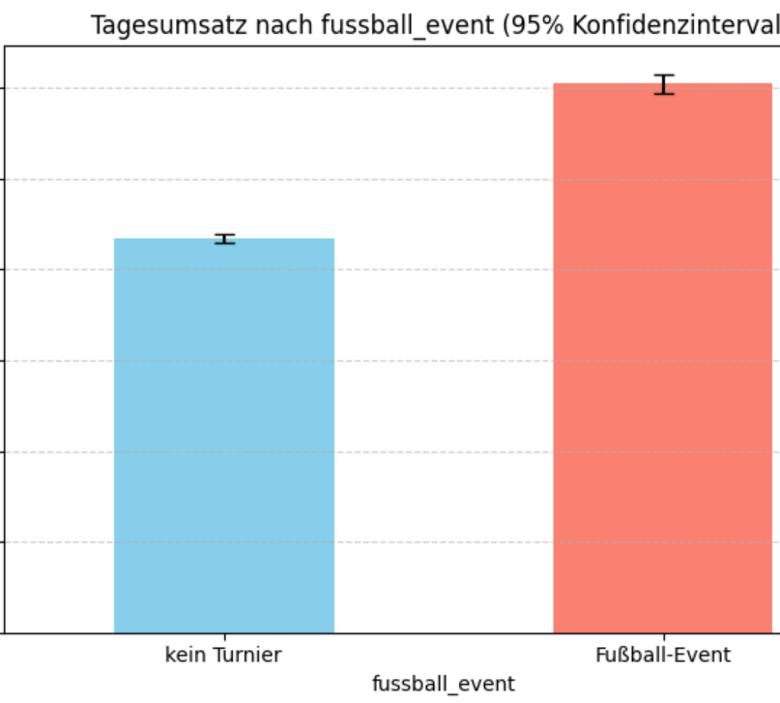
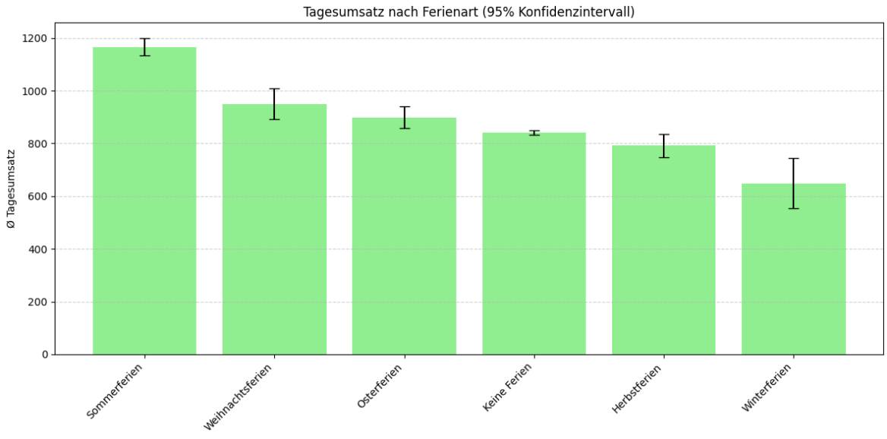
Bar charts for two self-created variables

Slide 9
Preprocessing Pipeline
1. Convert and standardize date fields
1
2. Merge temperature data
2
3. Extract features: day, month, weekday
3
4. Handle missing temperature values
4
5. Normalize for CNN, Linear Regression model.
5

Slide 10

BASELINE MODEL
We introduced a Linear Regression model as our initial estimator.
Built a Linear Regression model to predict sales (Umsatz) using both categorical
(e.g., Warengruppe, Feiertag) and numerical features (e.g., Temperatur, Bewoelkung).
Applied a preprocessing pipeline: imputed missing values, scaled numerical data,
and one-hot encoded categorical variables.
Combined preprocessing and modeling in a scikit-learn pipeline for clean, consistent, and
reproducible training and prediction.
Think of it as a ruler — it doesn't solve everything, but it tells you where you stand.

Slide 11
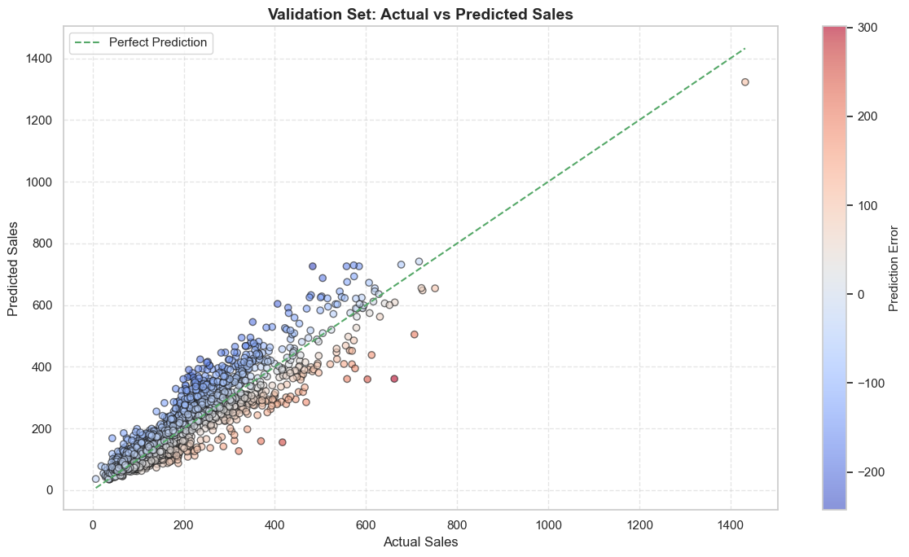
BASELINE MODEL
The scatter plot shows a strong linear relationship between actual and predicted sales, with most points close to the ideal prediction line — indicating good overall model accuracy.
The line chart confirms this by comparing actual and predicted values for a sample of cases, where most lines closely align.

Slide 12
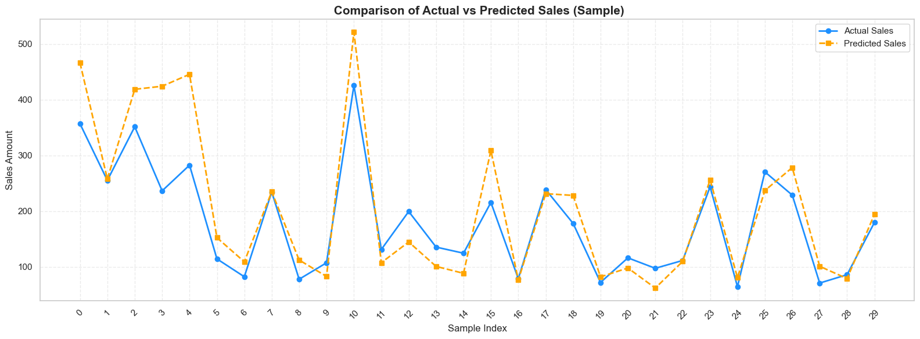
Actual vs Predicted Sales

Slide 13
Insights
• CNN performed better in generalization
• Linear regression works for simple patterns
• Date and temperature are key features

Slide 14
Conclusion & Future Work
• Extend to other product categories
• Explore LSTM or Transformer models
• Use external features like holidays, promotions

Slide 15
Thank You!
Any Questions?

